Slide 1
Home-Opoly

Slide 2
Previous Phase
Motivation.
Technology.
Brief explanation about the functional and Non functional requirements, basic prototypes and Ideas.

Slide 3
This Phase
Risk Management.
Database Design.
UI Design(for Login Page, Contact Page, Signup).
Learning Phase.
Implementation(User Management).

Slide 4
Risk Management
Skill set vs. project scope
Schedule vs. project scope
Technology platforms
Team Redundancy

Slide 5
Database
Team finalized on a database design.
Use of local database.
Online database will be used in the near future.
ER diagram and Schema Diagram are shown here.

Slide 6
ER-Diagram

Slide 7
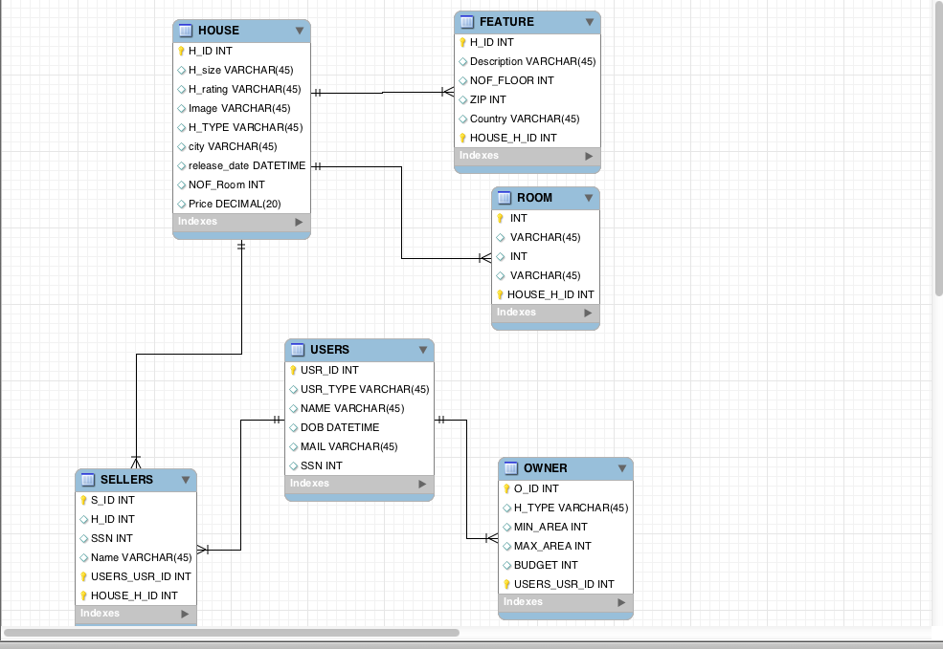
Schema Diagram

Slide 8
Entities and Relationship types.
House.
Feature.
Room.
Users.
Sellers.
Owner.

Slide 9
UI Design
Basic UI Designs for website has been done based on the ER diagram. This includes
Login Page.
Contact Page
Signup Page.
Registration Page.

Slide 10
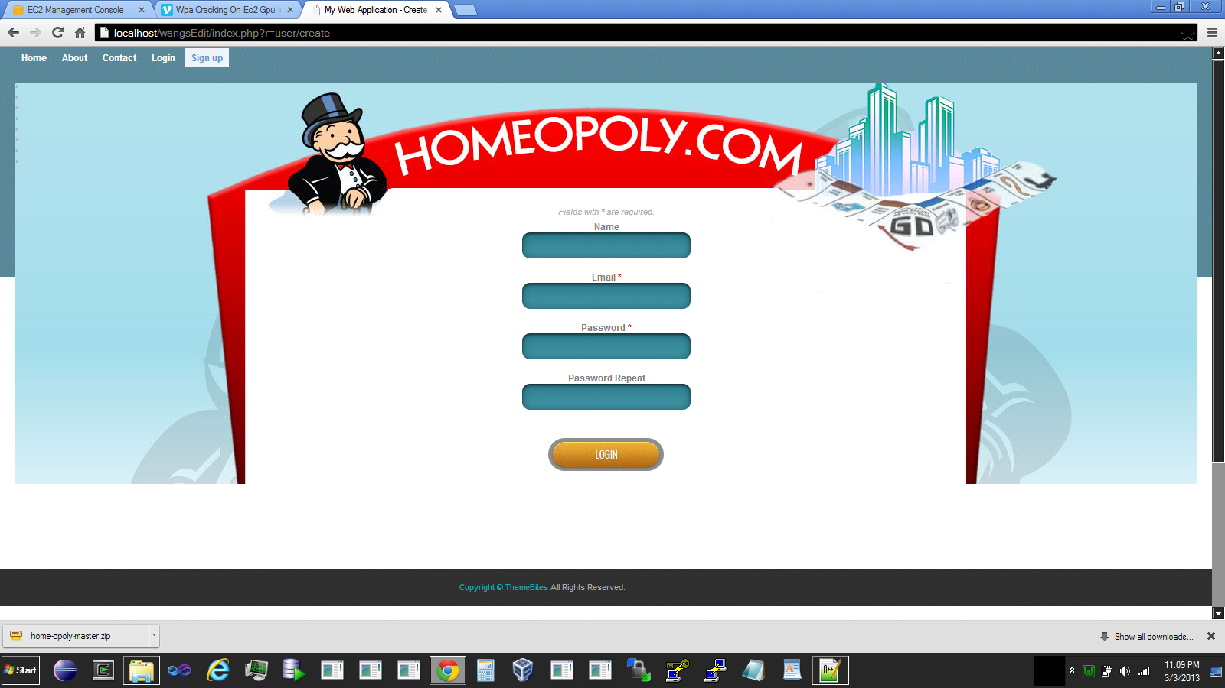
Signup Page

Slide 11
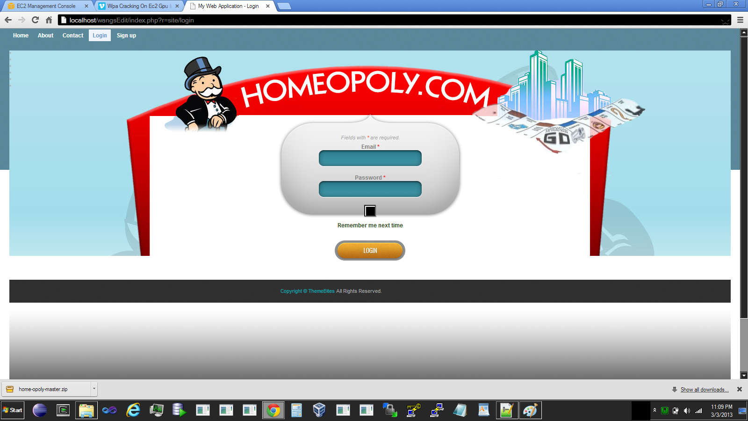
Login Page

Slide 12
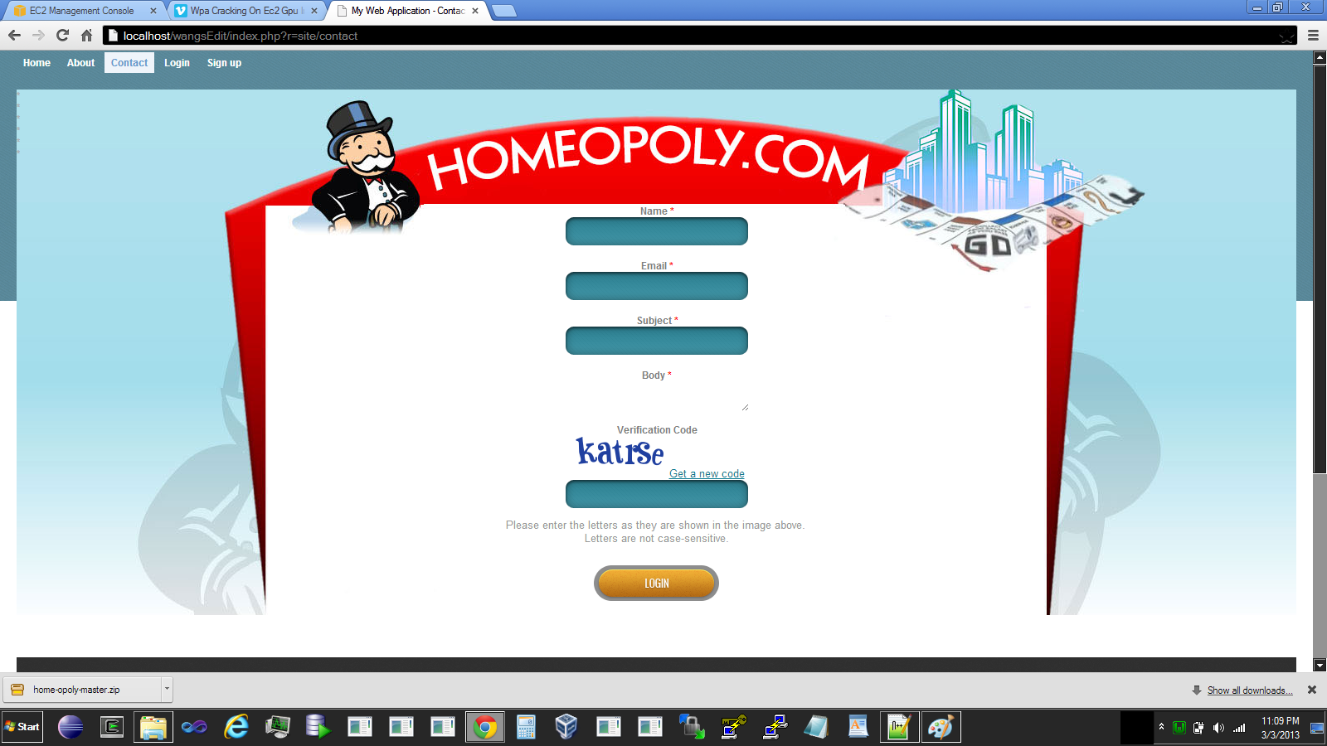
Contact Page

Slide 13
Learning Phase
Every member in the team had to go through this phase before starting the implementation. This includes
HTML
PHP
Yii framework.

Slide 14
YII Framework
Main feature: MVC application architecture.
Using Yii needs just a webserver which supports PHP 5.1 or higher.
Need not to learn new configuration.
Efficient.
Extensible.

Slide 15
Implementation
Home-opoly has been implemented using PHP as the scripting language.
Also usage of HTML, JQuery and style sheets
Following are implemented so far
User Management.
User Sign in.
User Sign up.

Slide 16
Unit Testing
Goal of the unit testing is to separate each part of the program as parts and show that each individual parts are correct.
PHP Unit: A unit testing framework for PHP.
So far:
Created a test data base
Wrote unit test for CRUD operations.
Tests on database connections.

Slide 17
System Testing
Test the components that have been delivered so far.
Every phase will have a system test cycle.
System test will continue for iteration 1 deliverables through the development cycle of iteration 2.

Slide 18
Thank you

